Slide 1
Task 3.3: Navigation for Mobile & Desktop
Minal Bombatkar

Slide 2
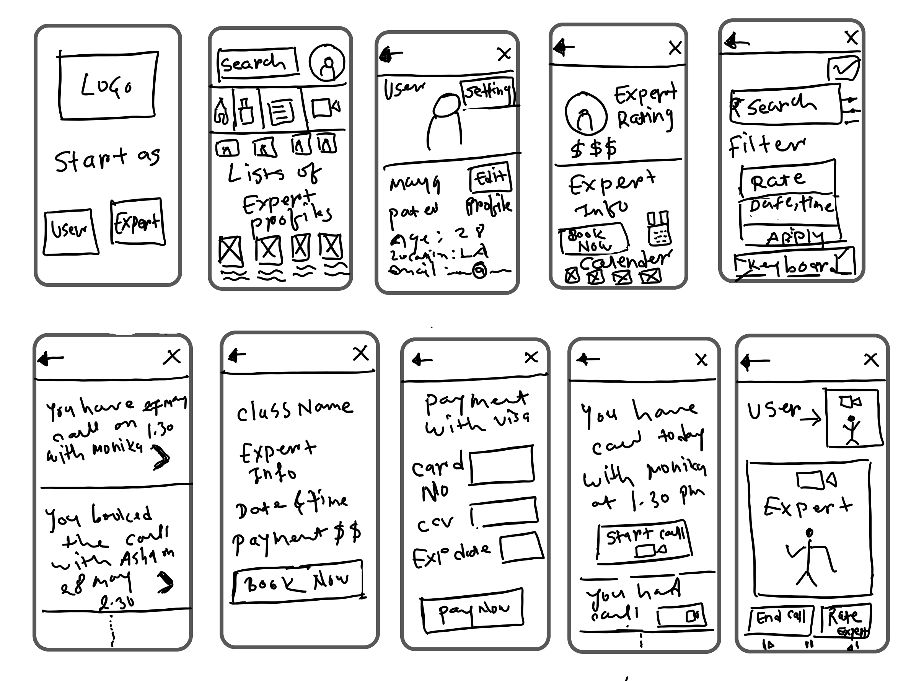
Navigation FOR YOGA EXPERT APP
Splash screen
Home screen
Splash screen would be simple with image and two buttons at the bottom.
Start as yoga user
Start as yoga expert
Home screen have access to
3. yoga user profile
4. Menu bar will have Home, Notification, Booking and Video call options
It will follows the list of experts
3
4
1
2

Slide 3
Navigation FOR YOGA EXPERT APP
5
User profile
Expert profile
Search screen
6
7
5. User profile with Edit profile and setting option
6. Expert profile with expert information,Rating and reviews and Calendar and payment
7. Search with Filter, Data would be sorted using filters. Such as
Price, Date and time, Language…

Slide 4
Navigation FOR YOGA EXPERT APP
8
Booking
9
Payment
Booking lists
10
8. Booking page will contain finalise information such as Class name, Expert name, data and time.
9. Payment using credit card
10.Booking list shows all the booking

Slide 5
Navigation FOR YOGA EXPERT APP
11
Notifications
12
Video call
11. Notification will have remainder for upcoming video call.
12. Through Video call users and yoga expert will communicate with each other.

Slide 6
Navigation FOR YOGA EXPERT APP
Summary:
For navigation, The main menu bar will be located only on the home page. Back button and Cancel button would be present on all the pages. So that user would access any page with one click of cancel button, it will be redirected to the home page. I decided to draw the complete navigation map for the yoga expert app, so that will help me to understand the complete scenario of the app.

Slide 7
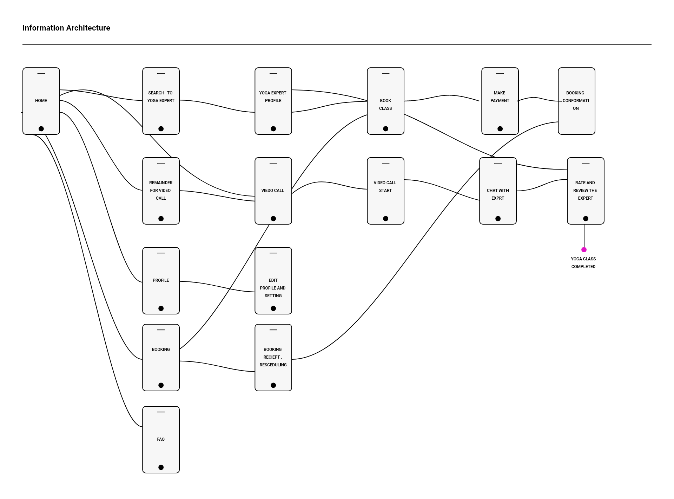
Navigation map FOR YOGA EXPERT APP

